Slide 1


Development of MCQ System
Module Project
Module: Programming Foundations
Course: Applied Degree in Software Engineering
Start Date : 26 October 2022
End Date : 23 November 2022
Submission Date :
Learner Name
Enrollment ID
:
:
Agung Yuda Pratama
BDSE-0922-076
Presentation Date : 15-01-2023

Slide 2

Document History
Version Number | Effective Date of release | Summary of Included Changes | Author
1 | 1 Jul 21 | First Edition | Jeyashree
2

Slide 3
Contents
Project Definition
Project Deliverables
Project Milestones & Tasks
Project Environment
Tools
Project Design
Classes & Methods
Steps from Coding to Execution
Development Process
Coding Standards
Milestone Feedback & Action Taken
Project Results
Proposed Improvements

Slide 4
1. Project Definition
Project Objective
Design, Implement, and Test MCQ System using Java.
Implement an application using IntelliJ or Eclipse.
Determine the debugging process and explain the importance of a coding standard
Proposed Solution
The system should handle multiple sets of MCQs. For example, Java Basics, Control Structure, HTML Basics, and the others.
Using The OOP Paradigm with Class and Method
The MCQ Test must easy to use

Slide 5
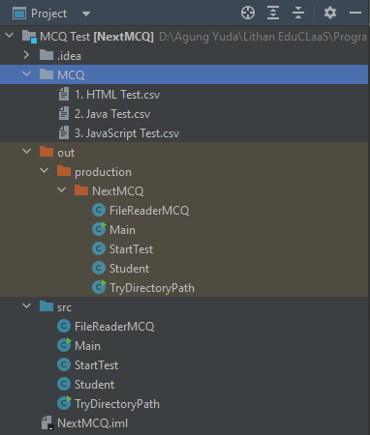
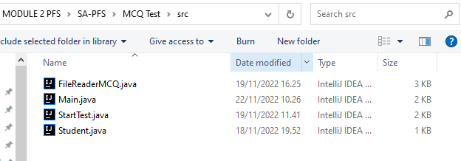
2. Project Deliverables
Project Deliverables
FileReaderMCQ.java
Main.java
StartTest.java
Student.java
HTML Test.csv
Java Test.csv
JavaScript Test.csv
List of Evidences

Slide 6
3. Project Milestones & Tasks
Project Task ID | Project Task Description | Project Milestone ID
1 | Create Requirement Specification | 1
2 | Develop Algorithm | 1
3 | Analysis and Design | 2
4 | Create the Application | 2
5 | Test the Application | 3

Slide 7
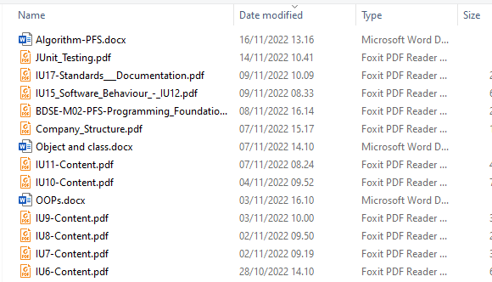
4. Project Environment
Technical Environment and Tools Used
Laptop Acer Aspire 5 A514-51G
Windows 10 version 21H1
Java JDK-18.0.2.1
IntelliJ IDEA
List of references
https://www.youtube.com/playlist?list=PLZS-MHyEIRo51w0Hmqi0C8h2KWNzDfo6F
https://www.linkedin.com/learning/intellij-idea-community-edition-essential-training/explore-intellij-idea-editions?u=112371770
https://www.youtube.com/playlist?list=PLZS-MHyEIRo6V4_vk1s1NcM2HoW5KFG7i

Slide 8
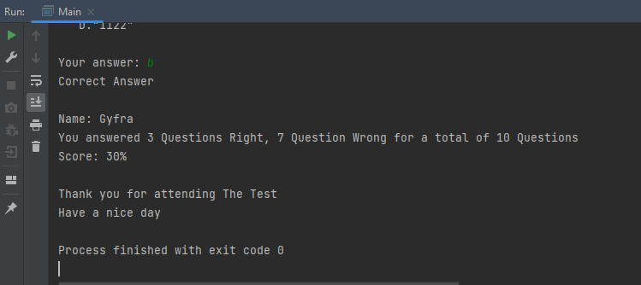
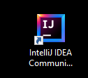
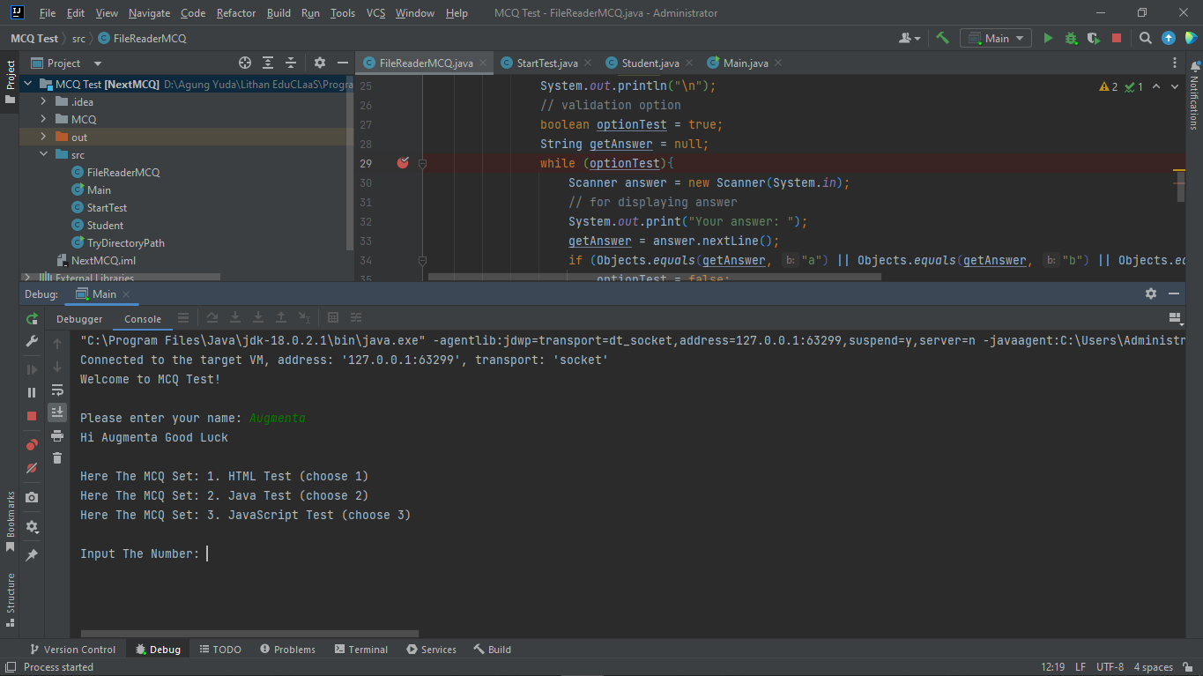
5. Tools
Screen capture of various tools used
Intellij IDEA
Run Tools
Debugging Tools

Slide 9
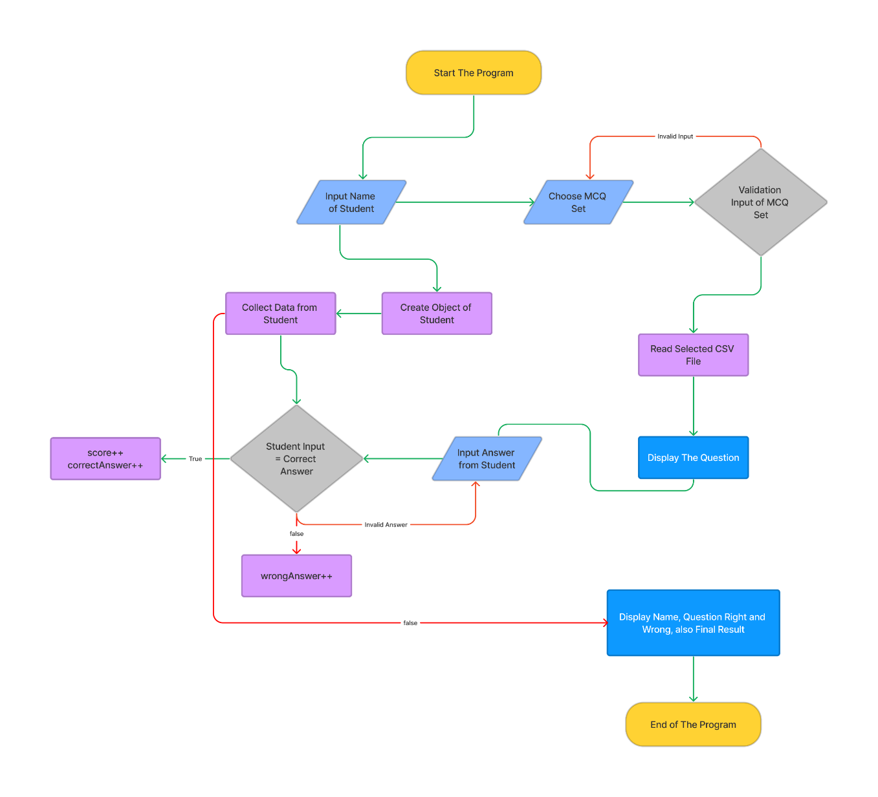
6. Project Design
System Design

Slide 10
7. Classes & Methods
List of Classes used
List of Methods used
FileReaderMCQ
StartTest
Student
Main
public void startTest
public void chooseTheTest
private void showFiles
public static int getScore
public void setName
public static void writeName
private static void selectMCQ
private static void showResult
public static void main

Slide 11
8. Steps from Coding to Execution
Application execution methods

Slide 12
8. Steps from Coding to Execution

Slide 13
8. Steps from Coding to Execution

Slide 14
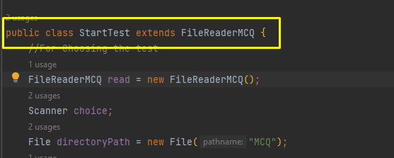
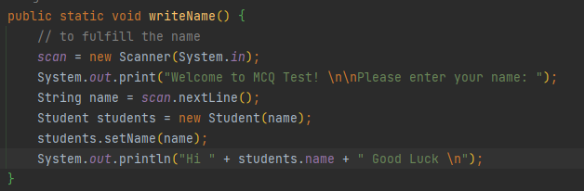
9. Development Process
Development using IDE and Debugging Mode
List down a note describing the program's workflow.
Choosing an understandable method name
Create a class for a certain group for certain processes. Don’t forget to inherit the class like this
Do not forget to make a method

Slide 15
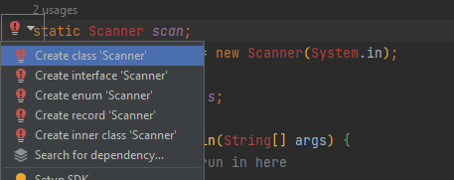
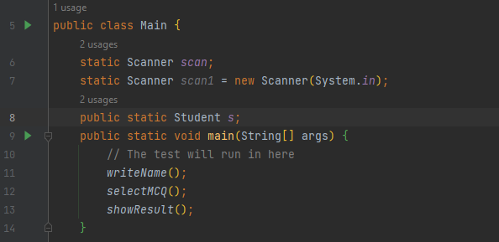
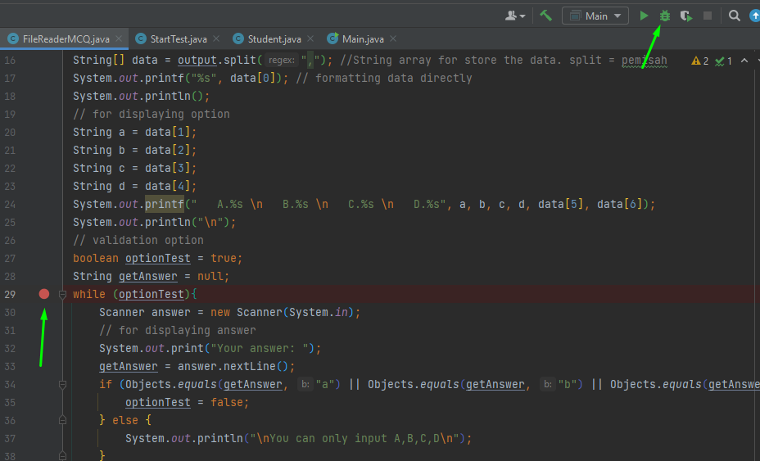
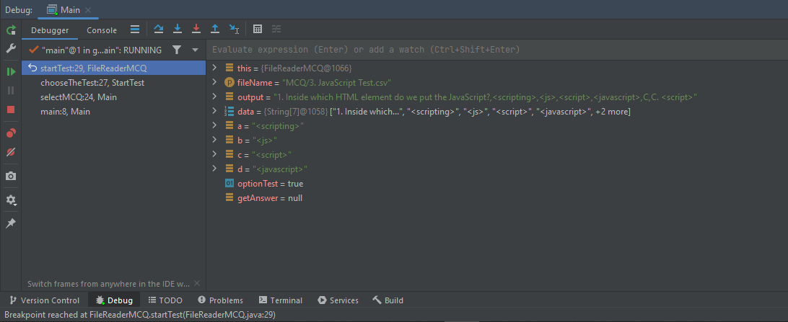
9. Development Process
When facing some issues with the code, the IDE will give a suggest.
This is when we debug the code

Slide 16
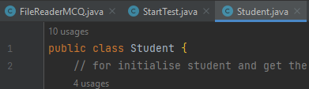
10. Coding Standards
Application of coding standards
Coding Standard for class :
a) The class name must start with uppercase.
class Student
b) If the class name is more than two words, the first letter must start with uppercase.
class StartTest
class FileReader
Coding Standard for variable :
I. The name should start with a lowercase letter.
output
data
answer
choice
read

Slide 17
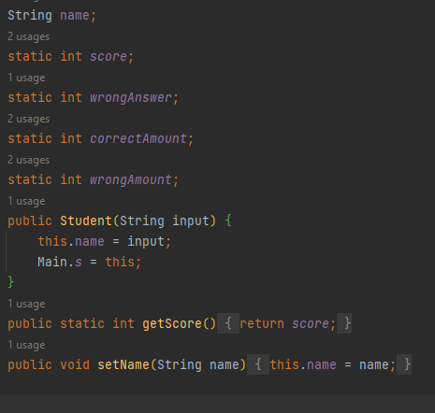
10. Coding Standards
II. The first letter must start with uppercase if the class name is more than two words.
directoryPath
trueChoice
userChoice
startTest
showFiles
Readability of The Code
If you make some code, you must make the function, the method, the variable, and other must easy to understand. Use some general object that everyone know that.

Slide 18
11. Milestone Feedback & Action taken
Project Milestone ID | Milestone Feedback received from Tutor / Learning Facilitator | Action Taken (Yes / No)
1
2
3

Slide 19
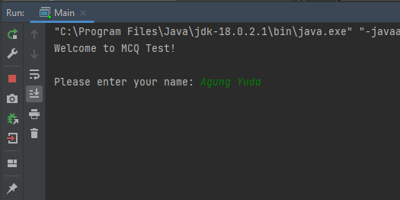
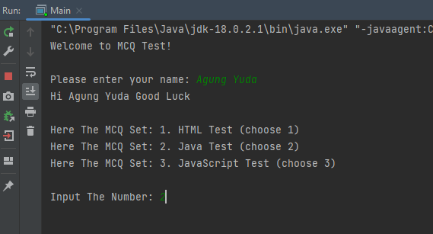
12. Project Results
Screen Shots of Evidences
User can Input their name.
After that the sytem will show The MCQ Test Set and User can choose The MCQ.

Slide 20
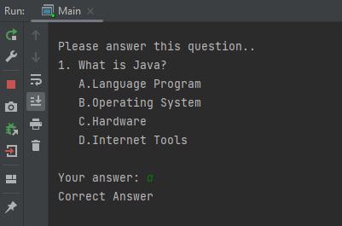
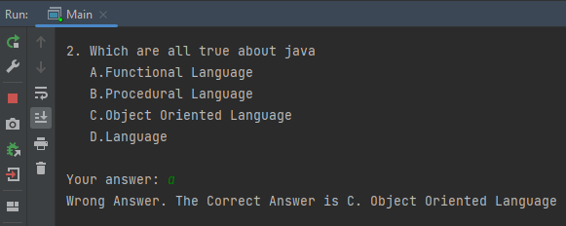
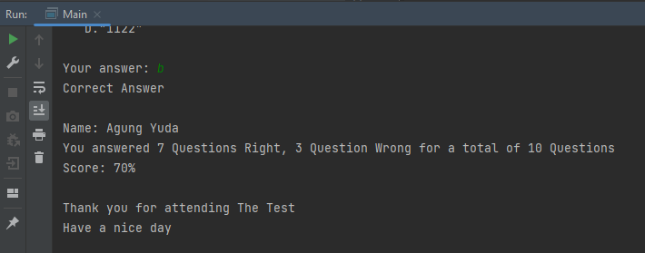
12. Project Results
Screen Shots of Evidences
Next, the question will show with the option. If your answer is right, there will be some validation and if you are the wrong answer also have validation.
In the last thing after user finish do the test. The Score will come up.

Slide 21
13. Proposed Improvements
List of Improvements
Improve my logic implementation
Learn different programming paradigms
Devise a plan for solving the problem.
Must try to understand how to arrange the program

